Slide 1
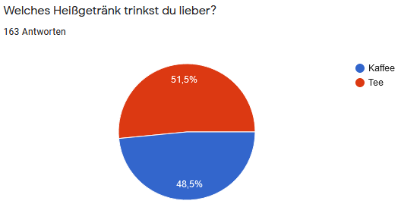
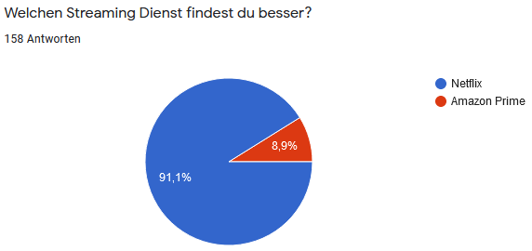
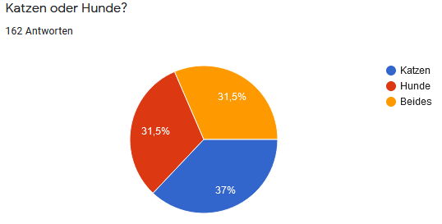
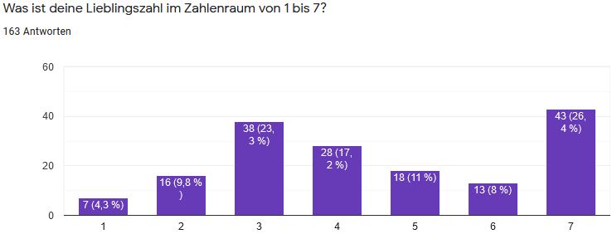
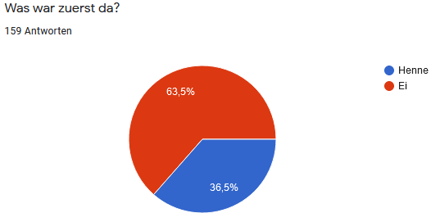
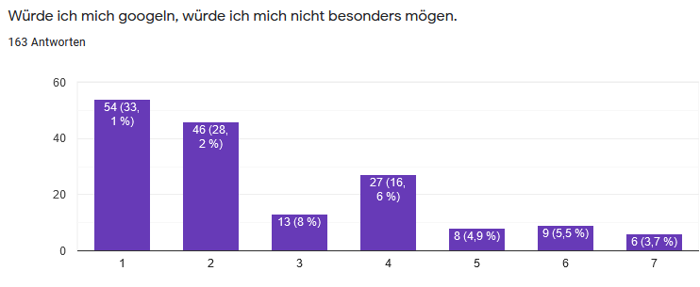
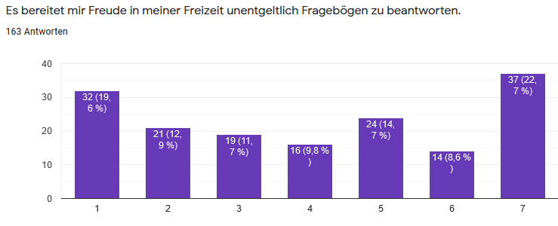
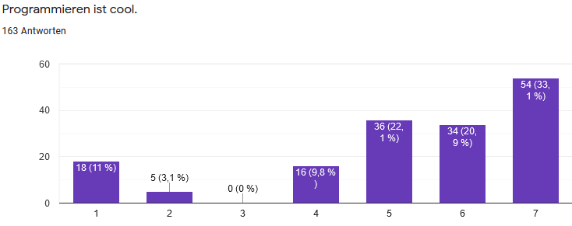
Final Assignment
Everything combined

Slide 2
Topics
Introduction: GUI and basic calculations
Coding 1: Scripts, style, and variable classes
Coding 2: Control statements and loops
Visualization 1: Basics, subplots, get and set
Coding 3: Functions
Visualization 2: Descriptive plots
Coding 4: Basic input and output
Visualization 3: Distribution and 3D plots
Coding 5: Input and output specials – last lecture before holidays
Machine Learning 1: Introduction and dimension reduction
Machine Learning 2: Clustering
Machine Learning 3: Classification
Coding 6: Efficiency and debugging basics
Coding 7: Advanced functions and debugging

Slide 3
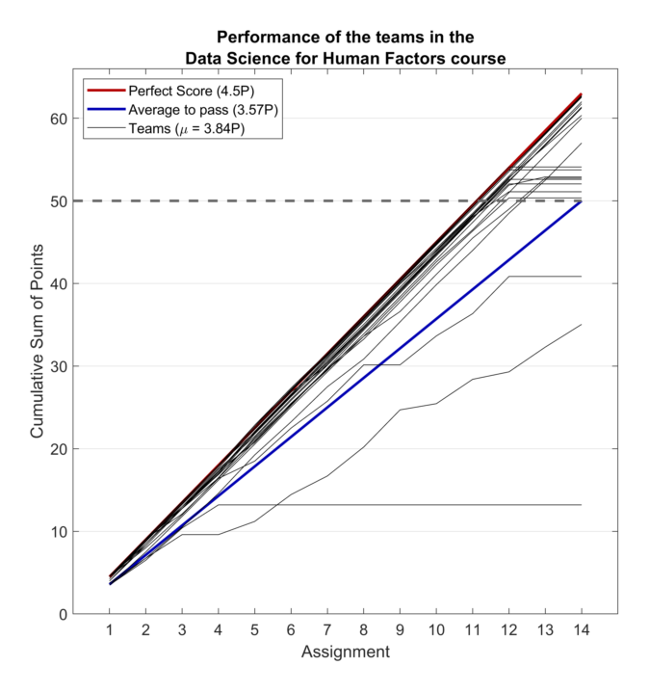
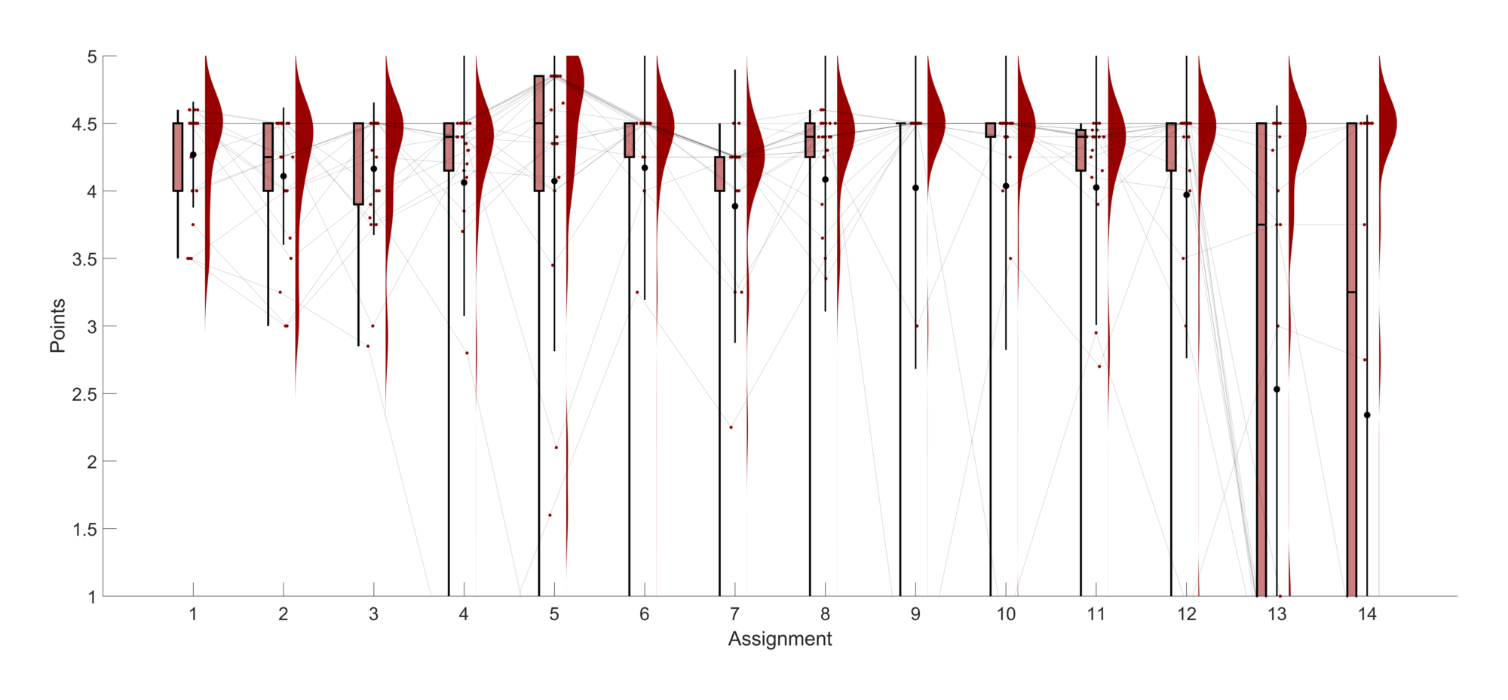

Slide 4
The final assignment
NOT in teams any more! You are on your own!
Deadline: 1 month from today! Enter grades in QUISPOS must be end of this semester… it might be possible to enter grades later but that must be done manually via the Prüfungsamt. If you need a deadline extension, let me know in advance!
The idea of this task is to combine all previous tasks
You know the “Kleiner unspezifischer Fragebogen” which you hopefully filled in (and sent around).
An EXCEL sheet with the answers will be available for download on ISIS
This questionnaire should now be analysed completely
You are quite free in how exactly you want to do this, just science the data!
Create a script that does the complete analysis (including running all subfunctions)
Comment which MATLAB version was used
No specific naming convention necessary
A few things are required, though, to show you mastered the course...

Slide 5
What I expect in the script(s)
Load the EXCEL sheet into MATLAB
Clean the data (remove all data of 2019)
Bring it in a usable form (some answers are numbers, others are text)
Use at least one for or while loop
Write a function and use it at least twice, choose sensibly why this should be done in a function.
Remember the help and input checks
Visualize the data as you see fit
All final plots have to have appropriate size, font size, axes, legends where due etc. In short, they should be real figures which are usable and you and I can show around.
Use subplots at least once. Other fancy plots are of course possible as well, but the main point is that the plots should fit the data.
Statistics are not a necessity, but correlations and t-tests could be a nice addition if you want to make a point (the functions are: corr, ttest)
This is not part of the course and thus won’t be graded but I will see and like it.
Concerning the ML part:
Use tsne at least once
Use clustering at least once
Explain whether or not the clustering makes sense in the case of this data and why you think that
Use classification at least once
There are many two-classes questions which might be predicted by the numerical questions
Examine whether your classification exceeds statistical chance at the alpha = 0.05 level
Make sense of your results, plot them in a meaningful way
Export your final figures, they should be self-explanatory
Movies/gifs don’t have to be used. If you find a nice way to do it, it’s great though, of course!
Create a zip file with your entire script and all nice exported plots. If it exceeds the ISIS data limit export the plots only as tif or jpeg, or hand in a link to another file hoster, or stop by my desk and hand it in manually.

Slide 6
Last but not least
Comment every step that is non-trivial
Explain your reasoning
Use clean code, sensible variable names, sensible sections
Make sure I, and any other person reading the code, can understand easily what is going on.
In short: Code well, not fast.
Have fun ☺ I think the questionnaire is quite interesting and I’m sure you will find things you are curious about in the data!

Slide 7
